Slide 1
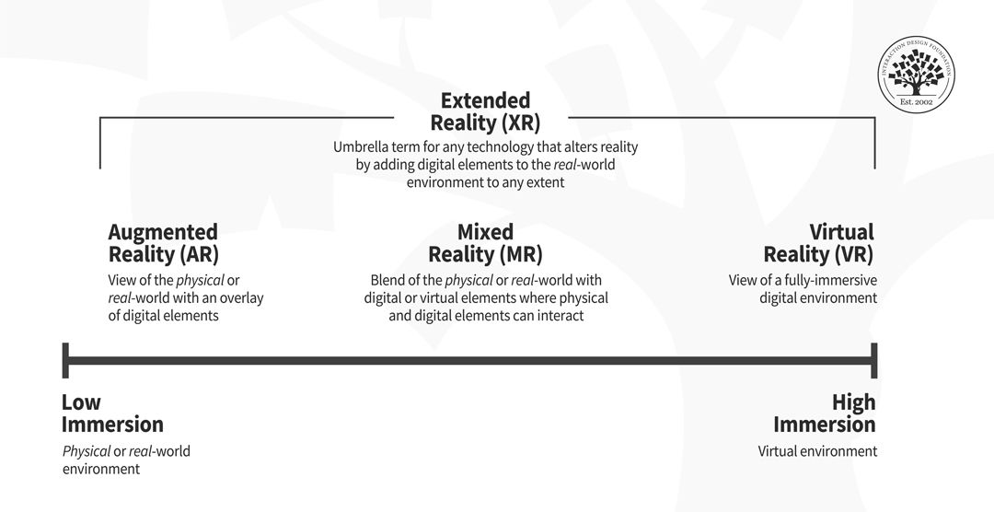
Augmented & Virtual Reality

Slide 2
How Does AR Work?
Augmented reality combines real-world sensory input with computer-generated real-time content using SLAM (Simultaneous Localization and Mapping).
Sensing and Tracking: The AR device senses the environment with cameras, accelerometers, gyroscopes, GPS, and even lasers to track the position and orientation of the user and their device.
Image Processing and Recognition: The system analyzes the sensor data and identifies objects or features in the environment that can be augmented. The device uses image processing and recognition algorithms to identify and track objects in real time.
Rendering and Display: The final step is to generate and display the computer-generated content on top of the real-world environment. This step renders and displays virtual objects in the correct perspective and position relative to the user's viewpoint. To the user it should seem as if the objects are really there, like a hologram.

Slide 3
To design successful experiences for AR consider
Safety: Remember users’ real-world contexts; don’t distract/mislead them into danger.
Overkill: Beware of drowning users’ senses with meaningless data; keep experiences contextualized.
Environment: Unlike desktop experiences, AR happens anywhere. So, the aim is primarily for users’ contexts regarding whether they’re outdoors/indoors and moving/static.
Public: Interacting with software, using the entire body
Personal: Using smartphones in public spaces
Intimate: Sitting, using a desktop
Private: Using a wearable
Comfort: Make comfortable designs to prevent physical strains and reduce cognitive load.
Security: AR data is rich, so design to ensure users’ data is secure.
Applications of Augmented Reality: Gaming, Education,Tourism, Marketing, Navigation, Healthcare, Architecture and Design

Slide 4
Virtual Reality – a technology that immerses users in a computer-generated 3D environment, simulating a realistic and interactive experience.
Head-Mounted Display (HMD): consisting of a headset or goggles with built-in screens and sensors. Tracks the user's head movements and adjusts the display.
Motion Tracking Sensors: VR systems use various sensors, such as accelerometers and positional tracking cameras, to monitor the user's movements in physical space. This allows users to interact with and navigate the virtual environment by moving their head, hands, or body.
Input Devices: VR experiences often incorporate input devices such as motion controllers, gloves, or handheld devices that enable users to interact with virtual objects, manipulate the environment, and perform actions within the VR world.
Computer Hardware and Graphics Processing: Powerful computing hardware, including high-performance CPUs and GPUs, is required to render complex 3D graphics and maintain smooth frame rates.
Software and Content: VR experiences are created using specialized software development tools and frameworks. This includes game engines like Unity and Unreal Engine, as well as VR-specific development kits provided by hardware manufacturers.

Slide 5
Information and data visualization – AR & VR
Spatial Visualization/ 3D Data Representation: AR and VR allow data to be visualized in three-dimensional space, enabling users to explore and interact with information - placing data points, graphs, charts, or maps within the user's physical environment (AR) or a virtual environment (VR), allowing users to move around and manipulate the visualized data.
Interactive Dashboards: create interactive dashboards and data visualization tools that users can interact with using gestures, voice commands, or motion controllers. These dashboards can display real-time data, trends, and insights, allowing users to analyze and explore data in a dynamic and engaging way.
Data Overlay: In AR applications, data can be overlaid onto real-world objects or surfaces, providing contextual information and enhancing situational awareness. For example, AR apps can overlay information about buildings, landmarks, or points of interest onto the user's view of their surroundings using location-based data.
Immersive Data Storytelling: create immersive data storytelling experiences, where users are guided through interactive narratives and visualizations that convey complex data-driven stories. These experiences can incorporate multimedia elements such as audio narration, animations, and simulations to engage users and convey information effectively.
Collaborative Visualization: This can be particularly useful for team-based decision-making, brainstorming sessions, or collaborative data exploration exercises.
Simulation and Modeling: VR can be used to create realistic simulations and models of complex systems, processes, or phenomena, allowing users to interact with and explore simulated data in a controlled virtual environment. This can be valuable for training, education, and research purposes.

Slide 6
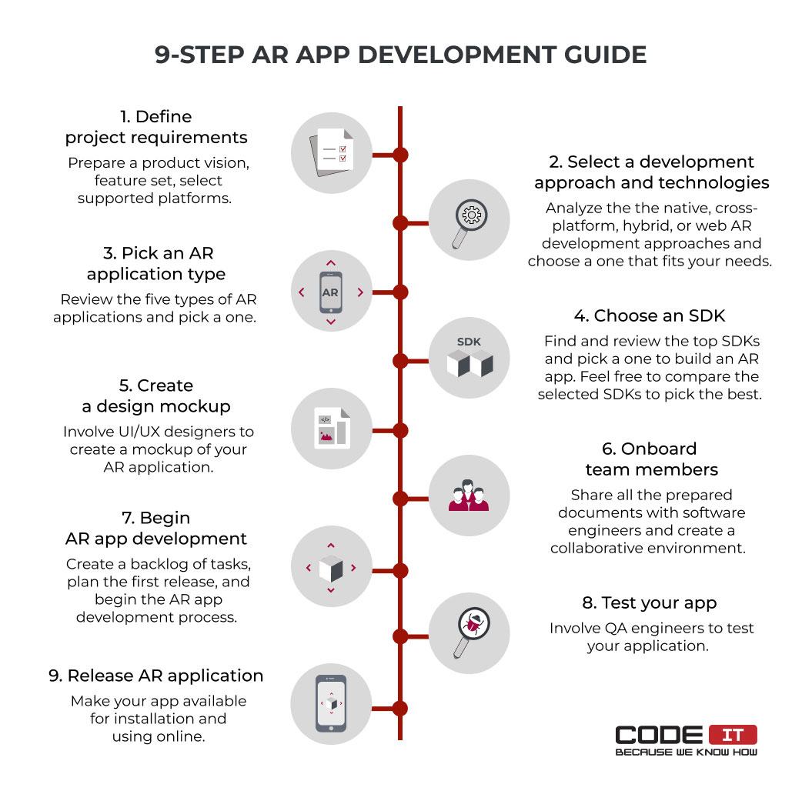

Slide 7
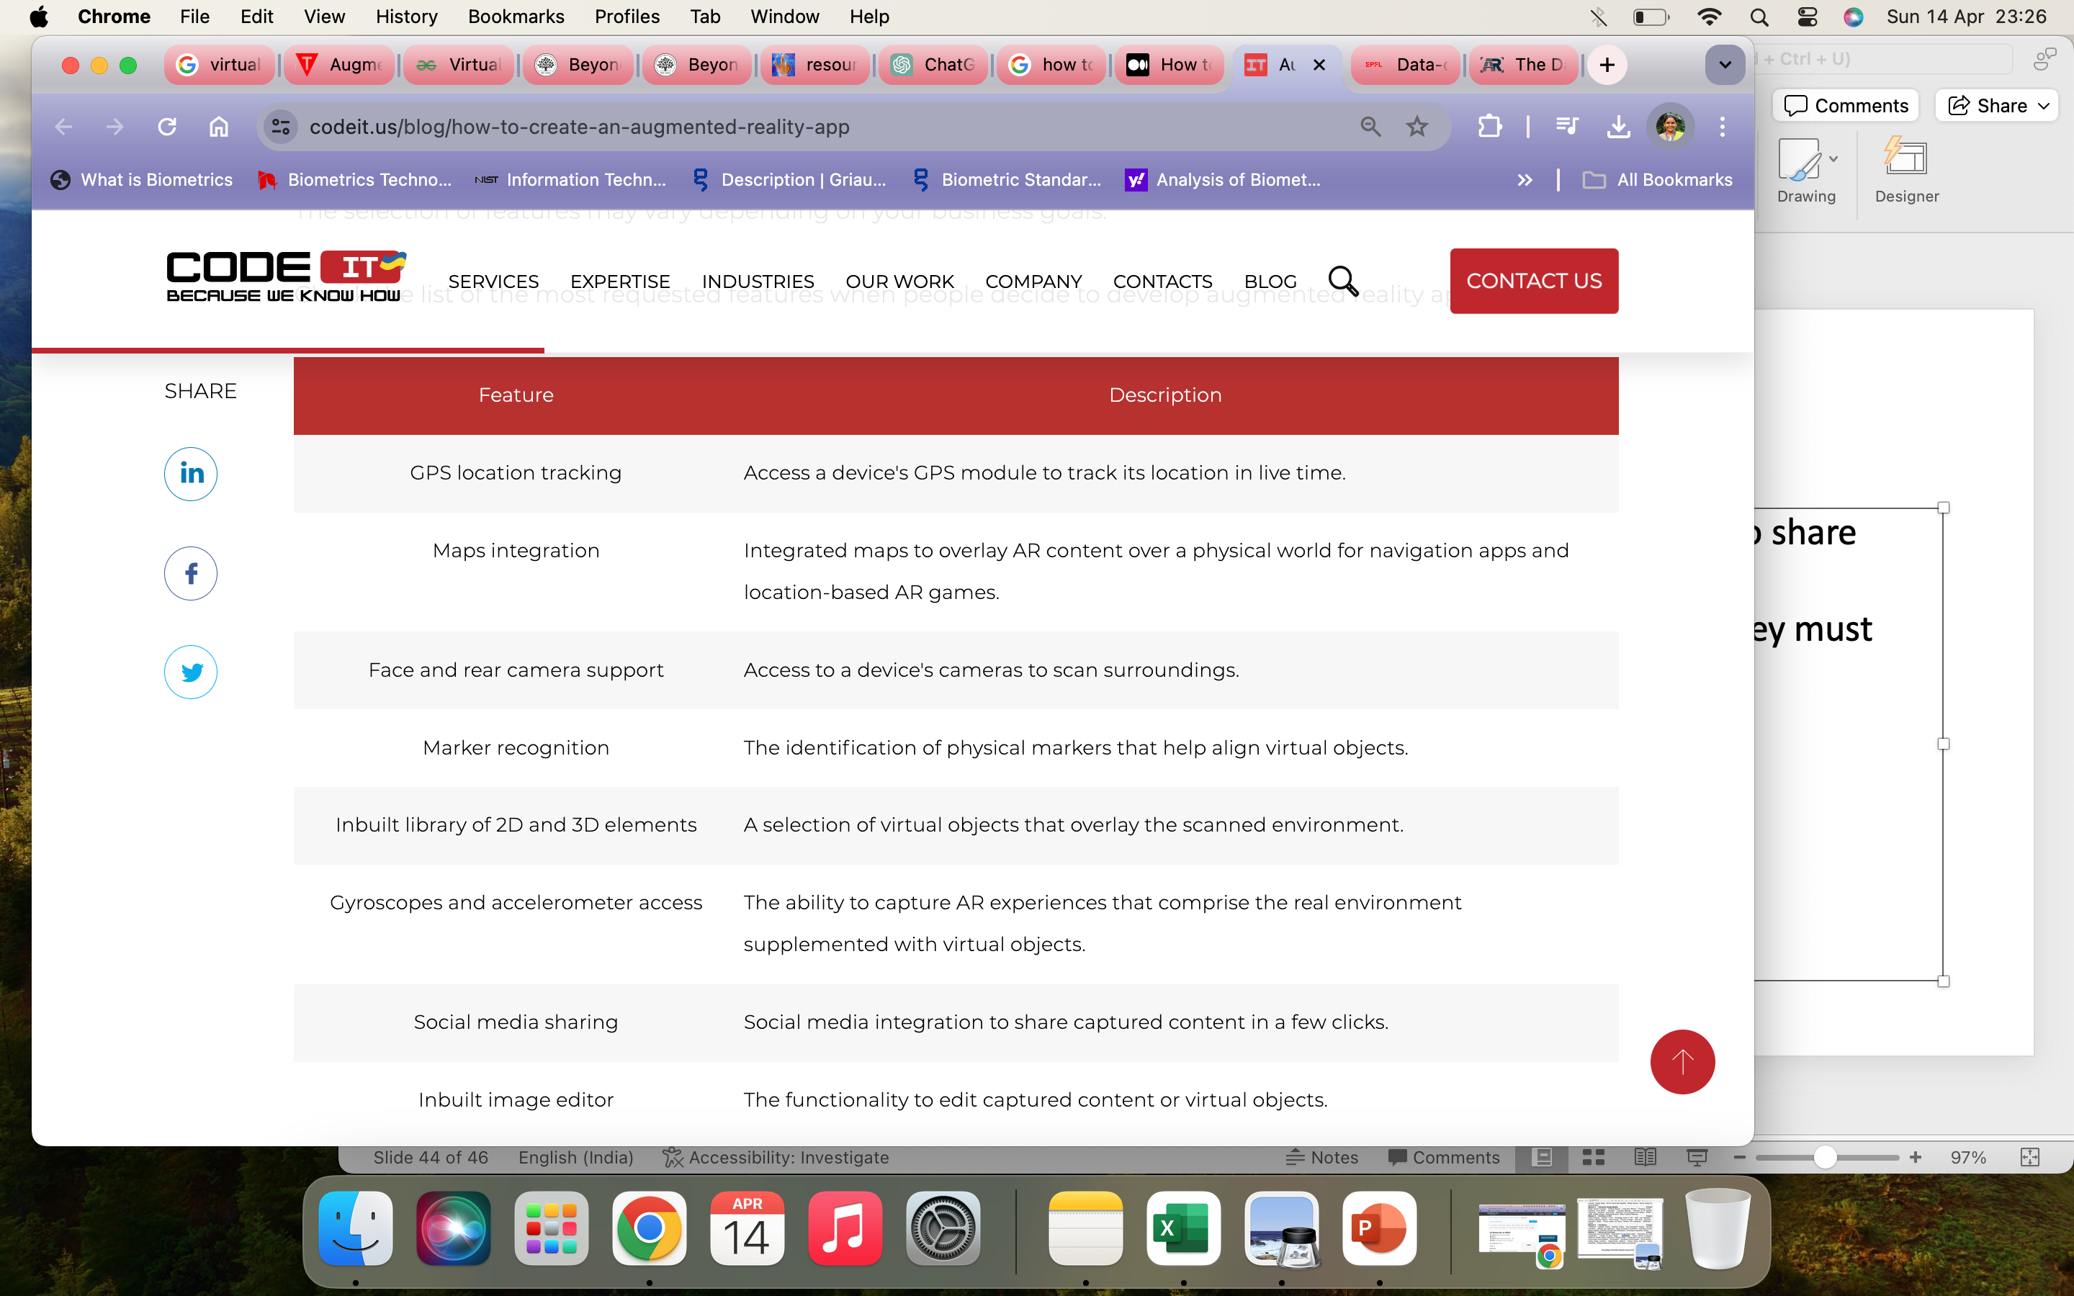
Feature Set
1. Define Project Requirements

Slide 8
2. Select a Development Approach and Technologies
Cross-platform: This approach requires using third-party frameworks and software development kits (SDKs) to create AR using one codebase. The approach helps lower the product development time and budget. However, there might be some functionality limitations and performance flaws. Eg programming langauges - C#, C++, Java, JavaScript
Hybrid: least popular AR app approach using the same codebase; hybrid apps are web-based applications that run on smartphones and tablets. Hence, they have poor functionality and performance issues. Eg programming langauges - HTML, CSS, JS
Web AR apps: can run in any compatible browser & works on many devices. Web apps can't work offline and have lower performance than native applications. Eg programming langauges – HTML, CSS, JS, Java, Python
Examples of programming languages used for native AR app development:
iOS, iPadOS, macOS — Swift and Objective-C
Android — Java, Kotlin
Windows — C#

Slide 9
3. Pick a Type of an AR Application
Projection-Based AR: Projects light, images, and objects onto surfaces interactively (Touch-responsive projections) or non-interactively (Creates illusions of position, orientation, or depth). Industries: Education, healthcare.
Examples: Hololamp: Projects 2D/3D virtual objects, Lumo Play: Interactive games projecting virtual content on floors.
Image Recognition AR: Recognizes images or objects to provide information using markers or OCR (Optical Character Recognition).
Examples: AR Flashcards: Enhances learning with AR animation, Zappar: Adds virtual content to physical items with scannable codes.
Location-Based AR: Uses GPS, accelerometers, and compasses to overlay AR objects based on location. Applications: Tourist information, location discovery, interactive maps.
Examples: Pokémon Go: Overlays virtual elements at GPS-defined locations, Google Maps: Augments directions with real-world views.
Superimposition-Based AR: Replaces or supplements real views with augmented elements. Applications: Healthcare (visualizing internal anatomy), military (highlighting objects).
Examples: IKEA Place: Visualizes furniture in real environments, Amikasa: Changes interiors with virtual furniture or colors.
Outlining AR: Highlights boundaries, paths, and edges using cameras and sensors. Applications: Parking assistance, construction planning.
Examples: AccuVein: Detects and outlines veins, GhostPacer: Projects a holographic training partner.

Slide 10
4. Choose an SDK
An SDK is a pack of tools to make the augmented reality app development process faster and prevent errors in the software you create. Special features can be added to your product.
Image recognition — the ability to detect, identify, and track 2D images.
Geo-location support — access to the location data gathered by a device.
3D tracking — the ability to identify 3D objects in a scanned environment and track them.
Cloud recognition — the ability to use a cloud-based database to recognize scanned objects.
SLAM support — the Simultaneous Localization and Mapping (SLAM) enables understanding of the physical space between scanned objects.
Smart glasses support — the inbuilt compatibility with the hardware and software used by augmented reality glasses.

Slide 11
5. Create a Design Mockup
Analyze your business requirements and create a mockup of your further AR application.
Feel free to involve UI/UX design experts to create a mockup and wireframes so that developers can understand how to create an augmented reality app in more detail.
It's vital to know that different platforms like iOS or Google need software engineers to follow defined style guides when building applications.
6. Onboard Team Members
Gather a team of software engineers who can develop an augmented reality application. Share all the prepared documents, so they can understand what they need to develop in more detail.
You may need to involve the following specialists to build an AR app: Web developers, Project manager, QA engineer, 2D/3D designer

Slide 12
7. Begin AR App Development
7.1 Planning
7.2 Coding
Software engineers have to develop the architecture of an AR app, using a selected SDK. Also, they need to develop the user interface and implement the defined features.
The tools and technologies to use for developing an AR application are defined by a selected SDK.
7.3 AR content creation and integration
Since AR apps overlay additional content over captured videos or photos, they are also required to create augmented reality objects using 3D modeling tools.
Alternatively, you can download a library of pre-built 2D/3D objects. The library of virtual objects needs to be integrated into the developed application.

Slide 13
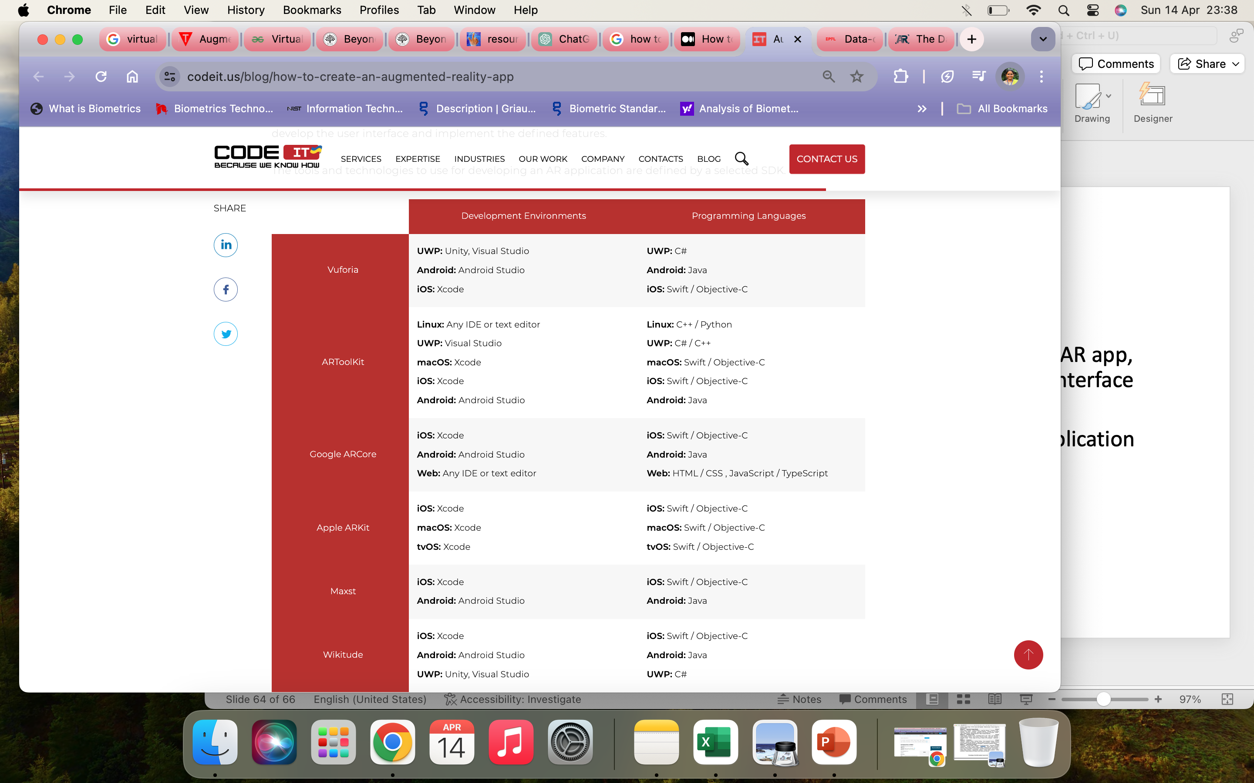

Slide 14
8. Test Your AR App
Involve quality assurance (QA) experts to ensure that features developed by software engineers work correctly and imply zero bugs. In case the developed functionality doesn't pass the acceptance testing, QA engineers need to prepare detailed reports so that developers can fix all the issues detected at the testing stage.

Slide 15
9. Release AR Application
If you've developed a mobile AR application, you should submit it to Google Play or AppStore so that users can install it on their devices. The app submission process involves the following steps:
Specify the information about an app in AppStore or Google Play Console
Create a logo and screenshots
Specify app privacy details
Upload your app and submit it for review
Monitor its status, number of downloads, and reviews
If you've developed a web-based AR application, you should do the following:
Select and purchase a domain name
Configure a cloud-based or on-premises server
Upload your app to a server
Install an SSL certificate (advisable)
Also, preparing technical documentation is recommended to facilitate the work of developers who will update, fix, or upgrade your AR application.

Slide 16
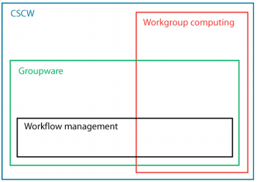
Computer Supported Cooperative Work
Workgroup Computing Vs. Workflow Management
Workgroup computing focuses on the information being processed and sharing of that info. Workflow emphasizes the importance of the process.
Workgroup computing is more flexible and spontaneous. Workflow systems need a set of rules to define the steps for the problem solving.
The user initiates & controls "workgroup computing" tools. Workflow is defined at the beginning of the process and then the Workflow system initiates the necessary actions to finish the task.
"Workgroup Computing" focuses on people working together at the same time to solve one big problem. The basic idea of Workflow is to divide the problem into several smaller sub-problems, which can be solved by different people.
The number of participants in Workflow systems is larger than Workgroup because of the difficulties in concurrency control and coordination.
“CSCW is about groups of users – how to design systems to support their work as a group
Groupware: "Computer-based systems that support groups of people engaged in a common task (or goal) and that provide an interface to a shared environment”

Slide 17
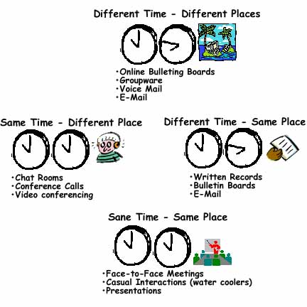
Groupware specific factors:
The time factor
Same-time, also referred as synchronous or real-time (when it is able to communicate only if the particular receiver is present at the same time - e.g. chat, audio/video communication).
Different-time, also referred as asynchronous (when it is able to communicate even if the receiver is not present and it is expected that the message is received by the receiver when he emerges online e.g. e-mail, newsgroups or forum)
The place factor (location of group members) - Same place , Different place
 | Same Place | Different Place
Same Time | Synchronous Local | Synchronous Remote
Different Time | Asynchronous Local | Asynchronous Remote

Slide 18
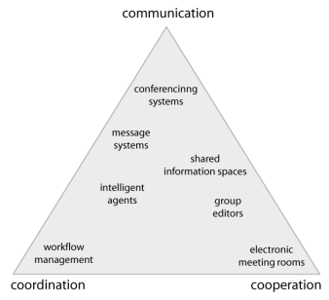
3C classification
This classification talks about the groupware system what is its main goal. Weather is it
communication,
coordination or
collaboration.

Slide 19
A list of functions provided by groupware
synchronous messaging: Chat systems (IRC, Livechat), instant messaging (Telegram, MSN messenger. Skype, Facebook Messenger).
asynchronous messaging : email, newsgroups.
message boards and forums: Allows posting of messages in more than one possible threads.
project management: This functionality includes creating projects, tasks, assigning tasks to workers, viewing project status, completeness, to do lists and more. Eg - JIRA
collaborative writing : Wikipedia
Virtual whiteboards, collaborative drawing and Mind Mapping Tools : Allows multiple users view and draw on a shared drawing surface.
multi – user audio/video communication and Screen sharing Tools: Eg - Zoom
decision support: This functionality provides voting, brainstorming, putting weight and probabilities on ideas and events.
document/file/contacts management: Allows sharing of documents, managing their accessibility to different classes of users, archiving and versioning of documents. Eg – Google Docs
resource management: Allows booking and managing resources like cars, rooms, technical equipment or even employee’s time.
Code Collaboration Platforms: Code collaboration platforms enable software developers to work together on codebases, projects, and repositories. Eg- GitHub
Social Networking Platforms: Social networking platforms provide spaces for users to connect, communicate, and share information with colleagues, peers, and communities. Eg - LinkedIn

Slide 20
Implementing synchronous groupware
Implementing synchronous groupware involves creating software systems that enable real-time collaboration and communication among
Define Requirements:
Clearly define the requirements for the synchronous groupware system based on the needs of the users and the goals of collaboration. Identify the key features and functionalities required, such as real-time messaging, document sharing, video conferencing, etc.
Select Technology Stack:
Choose the appropriate technology stack for building the synchronous groupware system. Consider factors such as scalability, performance, security, and compatibility with existing infrastructure. Common technologies used for synchronous groupware include web development frameworks, real-time communication protocols, and cloud services.
Design Architecture:
Design the architecture of the synchronous groupware system, including the overall system structure, components, and interactions between them. Consider factors such as scalability, fault tolerance, and data consistency. Choose an architecture that supports real-time communication and collaboration among multiple users. multiple users.

Slide 21
Implementing synchronous groupware
Develop Core Features:
Implement the core features of the synchronous groupware system, such as real-time messaging, document sharing, collaborative editing, video conferencing, and screen sharing. Use appropriate development frameworks and libraries to facilitate real-time communication and synchronization of data among users.
Integrate User Authentication and Authorization:
Implement user authentication and authorization mechanisms to ensure that only authorized users have access to the system and its features. Use secure authentication protocols and techniques to protect user credentials and sensitive data.
Implement User Interface:
Design and implement a user interface that provides intuitive access to the features of the synchronous groupware system. Consider factors such as ease of use, responsiveness, and accessibility across different devices and platforms. Provide visual cues and feedback to indicate real-time changes and updates.

Slide 22
Implementing synchronous groupware
Test and Quality Assurance:
Conduct thorough testing of the synchronous groupware system to identify and fix any bugs, errors, or usability issues. Perform functional testing, performance testing, and security testing to ensure that the system meets the requirements and performs reliably under various conditions.
Deployment and Maintenance:
Deploy the synchronous groupware system to production environments and make it available to users. Monitor system performance and user feedback, and address any issues or concerns that arise. Provide ongoing maintenance and support to ensure the continued reliability and functionality of the system.
User Training and Adoption:
Provide training and support to users to help them effectively use the synchronous groupware system. Create documentation, tutorials, and help resources to guide users through the features and functionalities of the system. Encourage user adoption and feedback to drive continuous improvement and refinement of the system.
Iterate and Improve:
Continuously gather user feedback and data analytics to identify areas for improvement and optimization. Iterate on the design and implementation of the synchronous groupware system based on user needs and evolving requirements. Incorporate new features, technologies, and best practices to enhance the overall user experience and effectiveness of the system.

Slide 23
Principle of Game Design
Step 1: Define the Core Experience - central theme and goals of the game. Consider the emotions and experiences you want players to feel throughout the game.
Step 2: Understand the Target Audience - Research and analyze the demographics, preferences, and behaviors of the intended players.
Step 3: Design Compelling Gameplay Mechanics - Develop core gameplay mechanics that are intuitive, interactive, and enjoyable.
Step 4: Create a Captivating Story or Setting - Develop characters, lore, and backstory that resonate with players and enhance the overall experience.
Step 5: Focus on Player Agency and Choice - Design gameplay scenarios that allow for multiple paths and outcomes based on player decisions.
Step 6: Foster Emotional Engagement - Create moments of tension, excitement, triumph, and empathy throughout the game thru visuals and sound effects.
Step 7: Ensure Pacing and Flow - Design levels, challenges, and progression systems that offer a sense of rhythm and momentum.
Step 8: Implement Feedback and Reward Systems - Design reward systems, such as achievements, collectibles, or unlockable content, to incentivize and motivate players.
Step 9: Test, Iterate, and Polish - Conduct playtesting with target players to gather feedback and identify areas for improvement.
Step 10: Launch and Support the Game - Prepare for the game's launch by marketing, promoting, and building anticipation.

Slide 24
Mobile Design: Elements of Mobile Design
Responsive Layouts: prioritizes layouts that adapt to different screen sizes and orientations.
Intuitive Navigation: Common navigation elements include hamburger menus, tabs, buttons, and gestures like swiping.
Clear Hierarchy: Mobile design often employs a clear hierarchy of information to guide users' attention and prioritize content. This includes using visual cues such as typography, color, and spacing to indicate importance and relationships between elements.
Optimized Typography: Designers often use larger font sizes, clear typefaces, and appropriate line spacing to ensure readability on mobile devices.
Efficient Use of Space: Mobile design requires efficient use of limited screen space to avoid clutter and ensure a streamlined user experience.
Touchable Elements: Buttons, links, and interactive elements should be large enough and properly spaced to prevent accidental taps.
Visual Feedback: Providing visual feedback for user interactions is crucial in mobile design to confirm actions and provide a sense of responsiveness.
Performance Optimization: optimizing images and multimedia content, minimizing loading times, and prioritizing essential content for faster access.
Accessibility: Mobile design should prioritize accessibility to ensure that all users, including those with disabilities, can access and use the app or website.

Slide 25
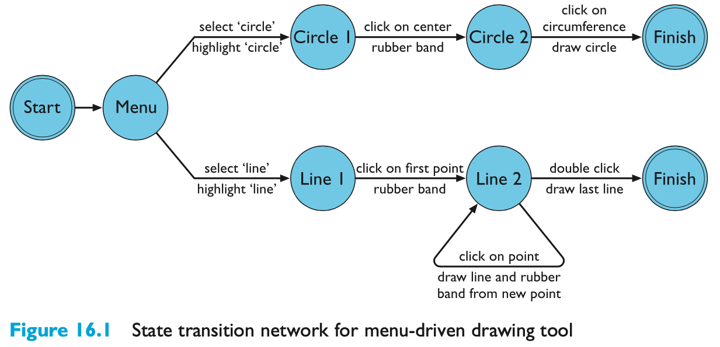
State transition networks (STN)
circles - states
arcs - actions/events

Slide 26
Hierarchical STNs
managing complex dialogues
named sub-dialogues
Graphics Submenu
select ‘graphics’
Main Menu
select ‘text’
Text Submenu
Paint Submenu
select ‘paint’

Slide 27
Concurrent dialogues - IV all together - combinatorial explosion
Text Style
NO
style
‘bold’
bold
only
bold
example
italic
‘underline’
‘underline’
underline
‘italic’
‘italic’
u’line
only
‘bold’
bold
u’line
‘italic’
‘italic’
italic
only
‘bold’
bold
italic
‘underline’
‘underline’
italic
u’line
‘bold’
bold
italic
u’line

Slide 28
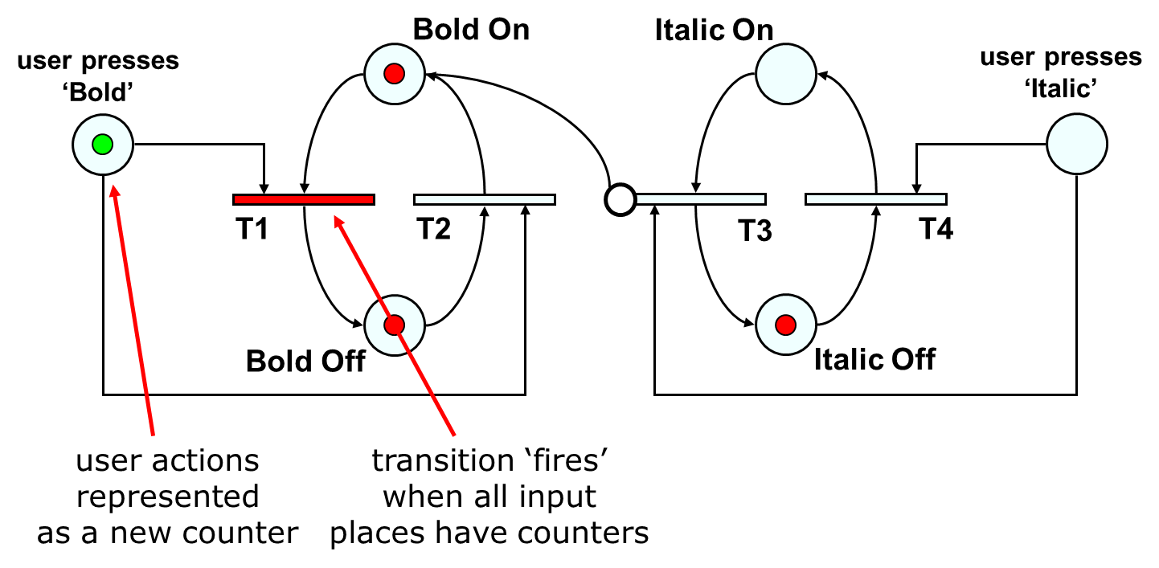
Petri nets
flow graph:
places – a bit like STN states
transitions – a bit like STN arcs
counters – sit on places (current state)
used for UI specification (ICO at Toulouse)

Slide 29
State charts
used in UML
extension to STN
hierarchy
concurrent sub-nets
escapes
OFF always active
history
link marked H goes back to last state on re-entering subdialogue
Standby
ON
OFF
RESET
Sound
Channel
1
H
On
SEL
2
MUTE
SEL
SEL
Off
3
SEL
4

Slide 30
JSD diagrams
for tree structured dialogues
less expressive
greater clarity
Personnel Record System
login
transaction
*
logout
add employee record
change employee record
display employee record
delete employee record

